Slide 1
Circuits Concept Builder

Slide 2
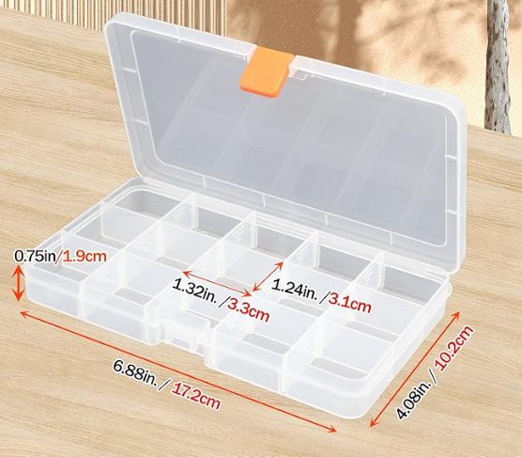
Overall Vision
PCB board will be powered by a single battery
Size is ~4x8” so that it can be housed inside a off the shelf DIY supply case.
Case will provide protection against the elements
Allow for stacking and protect from shorts in the circuit
PCB can be hot glued to the case
Focus of the circuits will be on fundamental concepts

Slide 3
Overall Board Layout
“Lucky 7” Circuits
Power supply
3.8”
Each circuit will have PADs for multimeter connections
6.8”

Slide 4
Overall Board Layout
“Lucky 7” Circuits
Power supply
4”
Each circuit will have PADs for multimeter connections
8”

Slide 5
Overall Board Layout
In top left of each subset, a switch to turn the circuit on/off
4”
8”

Slide 6
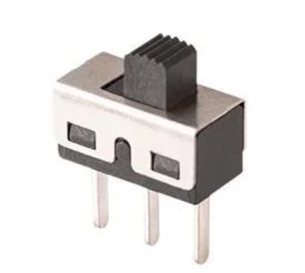
Power
Have a silk mask showing boundary (probably white)
Add a poly fuse
Master on/off switch
For now, use a 9V battery
Need battery holder
Place a master on/off switch right after the 9V battery
Create a battery voltage indicator
Red, yellow, green
Use transistors to do this
Use a linear regulator before sending out to the circuit
9V battery holder
Battery voltage indicator
Adj Linear regulator
Bank of LEDs showing voltage level

Slide 7
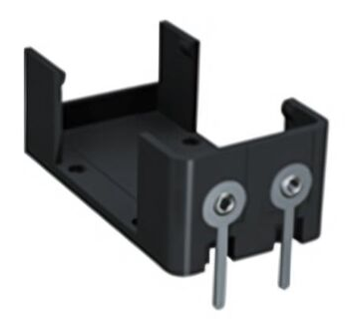
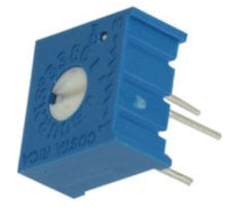
Power
Use a poly fuse (we will need to do current calcs to size)
Battery circuit monitor (use a comparator)
Look up curves for Amazon 9V batteries
Create fixed comparator for 7V. Turn on red LED if lower
Use and ADJUSTABLE linear regulator
Start with LM317 (add capacitor after to smooth)
Add square potentiometers with screwdriver faces (CHECK JLCPCB first to see what stock)
Use transistors to create a bank of LEDs.
As the voltage increases more LEDs turn on
Underneath each LED have a voltage number silk screened on the PCB
Have a test point if someone wants to measure directly with a multimeter.

Slide 8
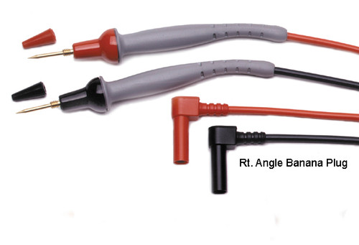
Test points
In every section of the PCB have test points so that a multimeter can easily probe.
Most have a slight taper at the end
Use a concentric circle design

Slide 9
General Components
Use Fusion360
Can do enough SPICE in it
Use 0805 resistors
Silk screen lots of names
Double sided PCB board
Larger trace size (so students can see it)
Do worst case analysis for poly fuse rating

Slide 10




Circuit 1 – Through and Across
Standard mini SMD slide switch
Learning goal
Current is through
Voltage is across
KVL, KCL, Sum P
PCB notes
Fixed resistors
Size R1 to be 2R2 so that the LEDS are different brightness
ADD MEASURE PADS all throughout
Test point
Dimension of PCB space
CIRCUIT 1
560$Ω$
LED
2
1
3
1000$Ω$
2000$Ω$
4
POWER
560$Ω$
LED
Blue switch shows if power is on
Black lines are masking AND components
Yellow is actual traces (add where needed)
When multimeter is connected to read current through orange pads 2+3 only then the LED will light up.

Slide 11





Circuit 2 – Voltage divider with Loads
Standard mini SMD slide switch
Learning Goals
10% rule
Voltage divider,
Sum P, KCL, KVL
Parallel / series
PCB notes
Fixed resistors
Make voltage drops unique across divider
ADD MEASURE PADS all throughout
Test point
Dimension of PCB space
CIRCUIT 2
1
1$kΩ$
2
1
2k$Ω$
$$6kΩ$$
3
2
3$kΩ$
2k$Ω$
4
POWER
560$Ω$
LED

Slide 12

Circuit 3 – Mixed DC and Can’t measure resistance in a LIVE circuit
Standard mini SMD slide switch
Learning Goals
Analysis techniques
PCB notes
Switches on either side of the potentiometer
ADD MEASURE PADS all throughout
Current source is this: (make it have the symbol on the silk screen)
https://www.jameco.com/z/LM334Z-LT65-5201--Linear-Technology-IC-LM334Z-LT65-5201-1-to-40V-10mA-Adjustable-Current-Sources-Cut-Tape_23739.html
Test point
Dimension of PCB space
CIRCUIT 3
1
1
2
1000$Ω$
1000$Ω$
LM134
2mA
1k$Ω potentiometer$
4
2
3
POWER
560$Ω$
LED

Slide 13
Circuit 4 – Series / Parallel with Lights
Learning Goals
Your model is only an approximation
Series/parallel
PCB Notes
Add measure pads
Add potentiometers
*** Add a switches to bypass all LEDS with a wire
Make sure source can disconnect on both sides
switch

Slide 14
Circuit 5 – RC time constant
switch
Learning goal
Transient
555 timer
PCB
Have switch to turn on/off square wave
Have potentiometer to set frequency
Have two R values and a switch to change.
LED should fade in and out
555 Timer w/ external pot for frequency control

Slide 15
Circuit 6 – Dependent Voltage Source
Learning Goals
Dependent source
Power
PCB Notes
Use LM358 (or equivalent) single sided op-amp
Have non-inverting configuration w/ fixed gain of 2
PADs to measure
Switch (also for op-amp power)
To non-inverting op-amp
Single sided op-amp w/ Gain of 2

Slide 16
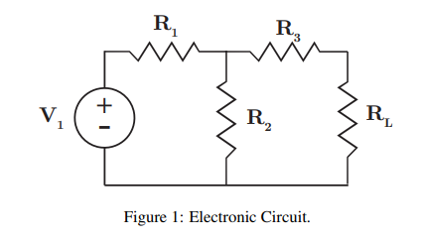
Circuit 7 - Thevenin
Four corner the switches!
Learning Goals
Thevenin
Max power transfer
PCB Notes
Four corner the switches
PADS
Let $R_{1}=560Ω, R_{2}=1500Ω, R_{3}=220Ω, and V_{1}=9V$.

